Slide 1
Software Engineering
201735849 안세훈 201735871 장 건
201835451 박다정 201935038 노민하

Slide 2
Contents
Q&A
Objective
Service
&
Function
Progress
Plan
Member’s
Role
▶
▶
▶

Slide 3

Objective
Suppose that you are living in dormitory.
And you may think..
“ Hmm.. I like to eat delivery food.
But with whom..?”
Communal Order
System!

Slide 4

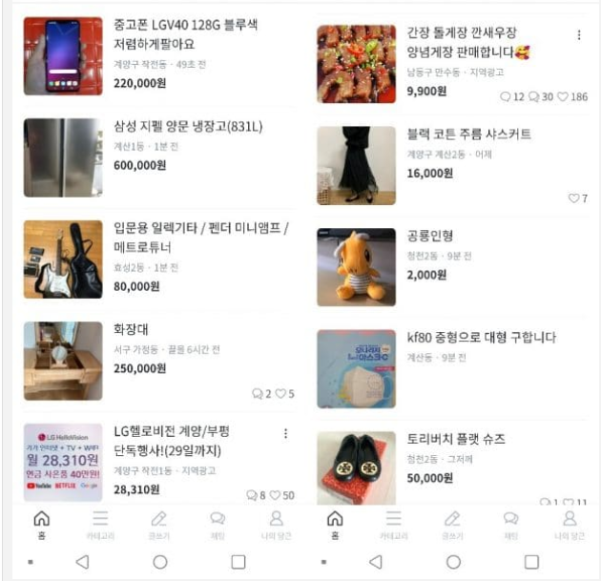
Service & Function
<Food Delivery>
<Community>

Slide 5
Service & Function
Recruitment Complete
Personal Management
Send push notification
Meet together
- Split the bill
- Eat the food together
01
02
03
Creating a Post
Check the food to eat
Participate in

Slide 6
Progress Plan
Requirements
&
Firebase Study
Design and Implementation
4/13
4/29
5/6
5/13
5/25
Topic Development
System Modeling
&
Architecture Design
Software Testing &
Final summary

Slide 7



Member Role
Back-End
Front-End
Leader
안세훈
장건
박다정
노민하
Regular Meeting : Every Tuesday at 8’o clock.

Slide 8
Thank you!
Any question?

